Slide 1



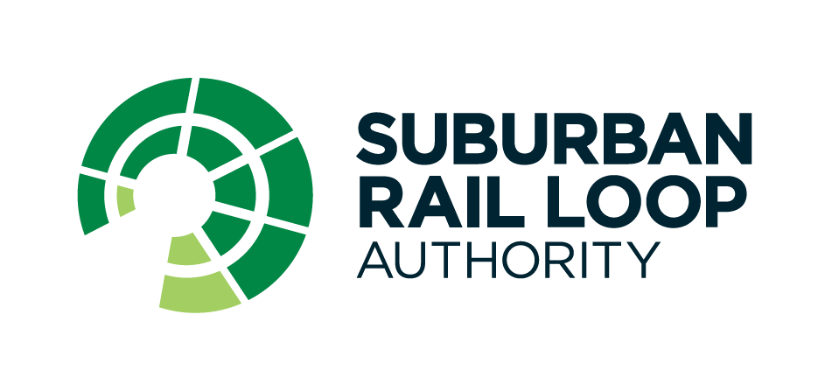
www.intelia.ai
Case Study – Data ingestion and Workforce Planning Power BI report
Data Analysis
Data mapping
Data quality reconciliation
Problem
Solution
The Suburban Rail Loop is an ambitious project uplifting Victoria's rail network, transforming daily travel for millions of commuters. With so many people expected to work on the project over time, it's imperative that the Suburban Rail Loop Authority (SRLA) has capability to effectively manage resources. Full transparency across resource utilisation, forecasting and recruitment is key for the SRLA to successfully plan and budget for the project with as much accuracy as possible.
Given intelia’s expertise with data pipelines and visualisations, we were engaged to provide a solution to allow SRLA to see the current state of resource allocations as well as forecast future resource needs.
The solution included the following;
•Data Analysis: Identifying gaps, discrepancies, or missing data within the existing data sources by conducting thorough data analysis. Ensuring proper alignment of data through the mapping of data fields to ensure consistency and accuracy in the analysis.
•Building Medallion Architecture for Data Storage: the solution involved designing a robust architecture that facilitated data processing, storage, and analysis efficiently. We implemented a three-layer data lake in Microsoft Fabric; the Microsoft analytics solution as per the project requirements.
•Data Sourcing and Ingestion Pipeline: intelia developed automated pipelines to streamline the data sourcing and data flow, ensuring timely and accurate data delivery using the Azure Data Factory feature of Microsoft Fabric.
•Launch Power BI Dashboard: intelia applied adjustments on the dashboard, creating Direct Lake connections to the data lake and deploying the dashboard to the target environment in Microsoft Fabric, making it accessible to the intended users. Additionally, we provided necessary training and supporting documents for its use.
Data Pipeline
EcoSys
Azure Data Factory
Azure Microsoft Fabric
Data Visualisation
Power BI
intelia’s Approach
SRLA
Suburban Rail Loop Authority (SRLA) is responsible for planning and delivering Suburban Rail Loop (SRL), the largest infrastructure project in Victoria’s history and the state’s biggest investment in transport and precinct development.
The Workforce Planning Data project required a streamlined report to optimise and manage resources for the SRL project. Leveraging data from EcoSys, a system that consolidates resource and position information from multiple sources, was essential. Through consultation with subject matter experts, intelia conducted a comprehensive analysis of SRLA’s resource/HR data identifying the necessary HR data integration points and consolidated the required data into a Microsoft Fabric data lake. Adopting the approach of “not reinventing the wheel”, intelia leveraged the existing Power BI report utilised by another department, Major Transport Infrastructure Authority (MTIA). From there, intelia configured the Power BI report to seamlessly load the HR data, allowing SRLA to surface the desired data with the Workforce Planning report.
Outcome
The efforts undertaken resulted in significant outcomes. Firstly, there's a noticeable improvement in data integrity as discrepancies and missing data elements are identified and corrected, leading to more reliable insights and decisions. Secondly, the careful alignment of data from various sources ensures consistency and accuracy during analysis, reinforcing the trustworthiness of the conclusions drawn. This enhances stakeholders' ability to make informed decisions confidently based on the insights obtained.
Additional SRLA project work: Following the success of the Workforce Planning Data project, intelia was recently engaged to work on the ‘CEO Dashboard Monthly Reporting’ project, where we successfully delivered the Risk, Schedule, Cost and CEO Power BI reports using data sourced from the eDAR data platform.
With offices in Melbourne and Sydney, intelia is a technology consultancy specialising in all things data (strategy, architecture, governance, analytics, modern cloud data platforms and intelligent automation)

